Slide 1
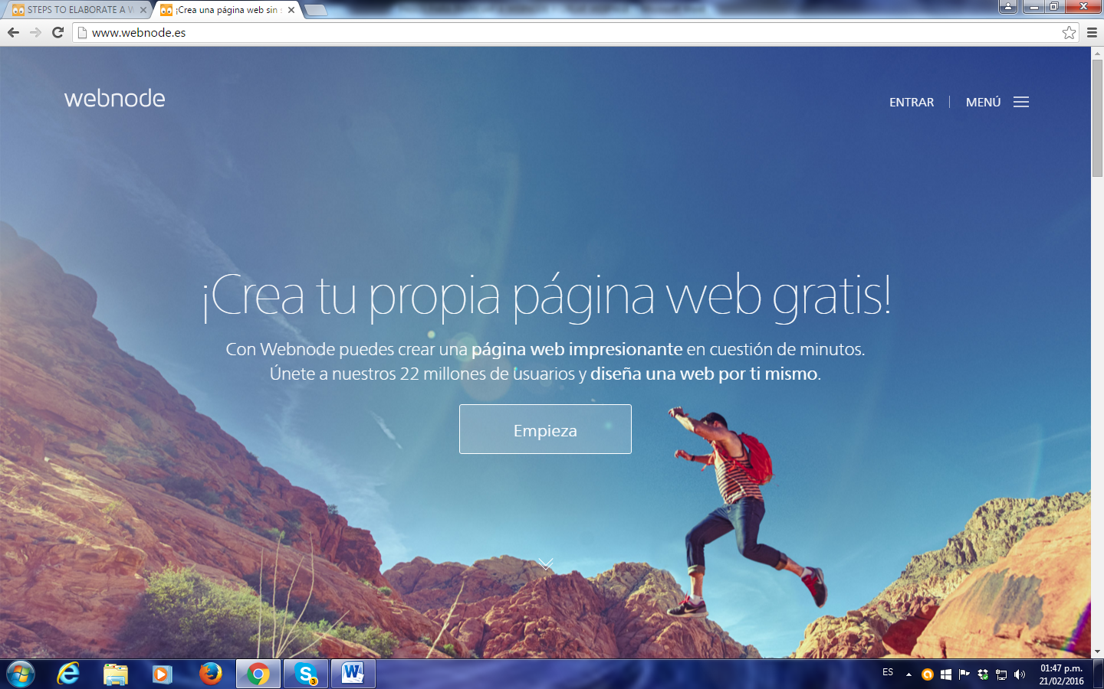
Type the address
This is the screen that appears

Slide 2
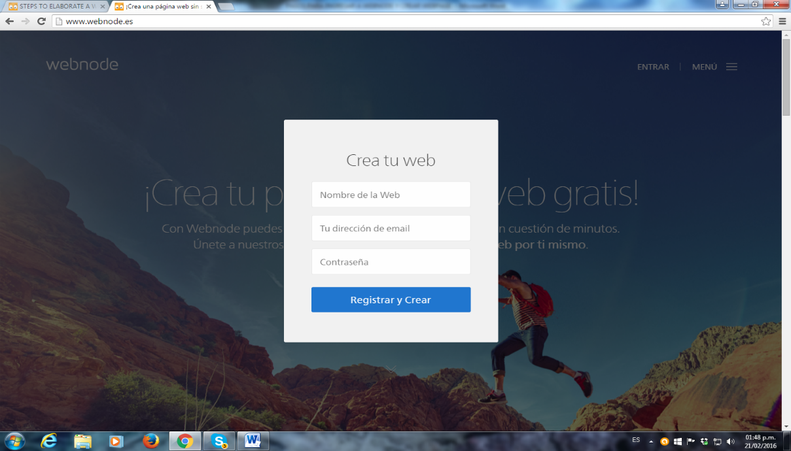
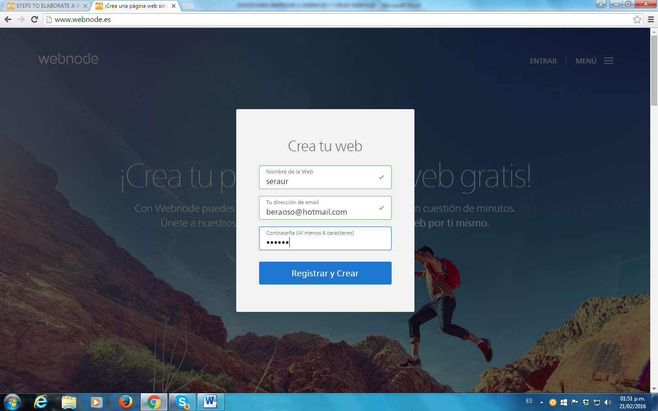
Make click and type the web address you want to generate.
Type your e-mail address and your password, you will Access to your page with it. Click in register and create.

Slide 3
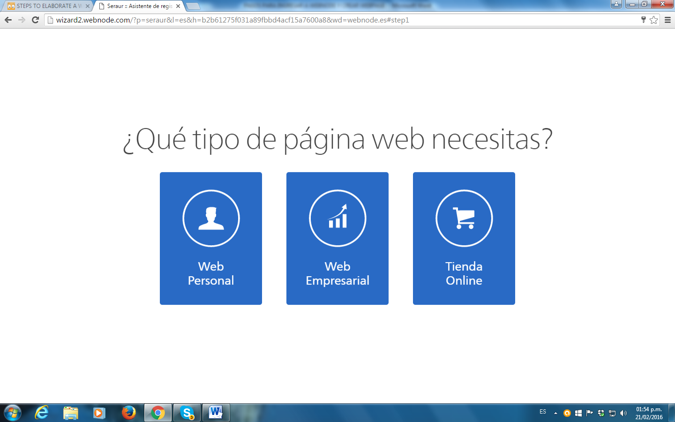
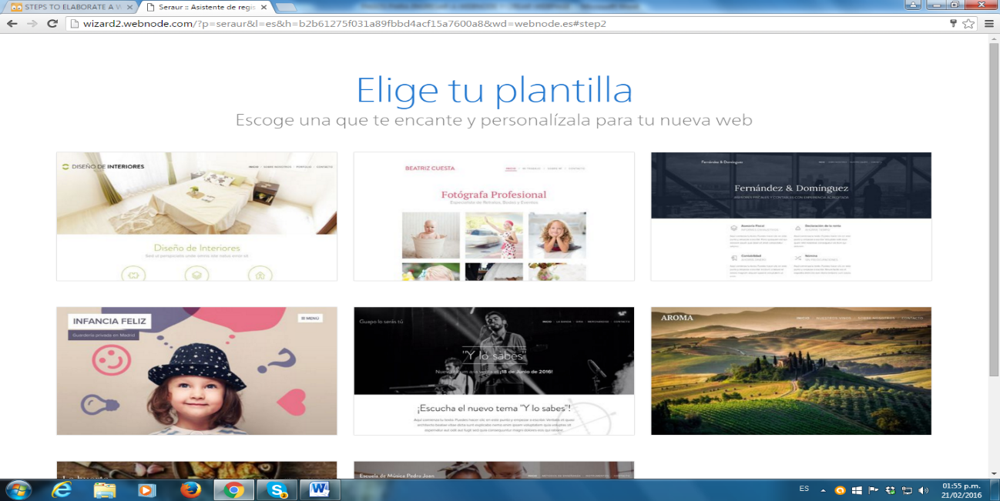
Choose personal web.
Choose the template.

Slide 4
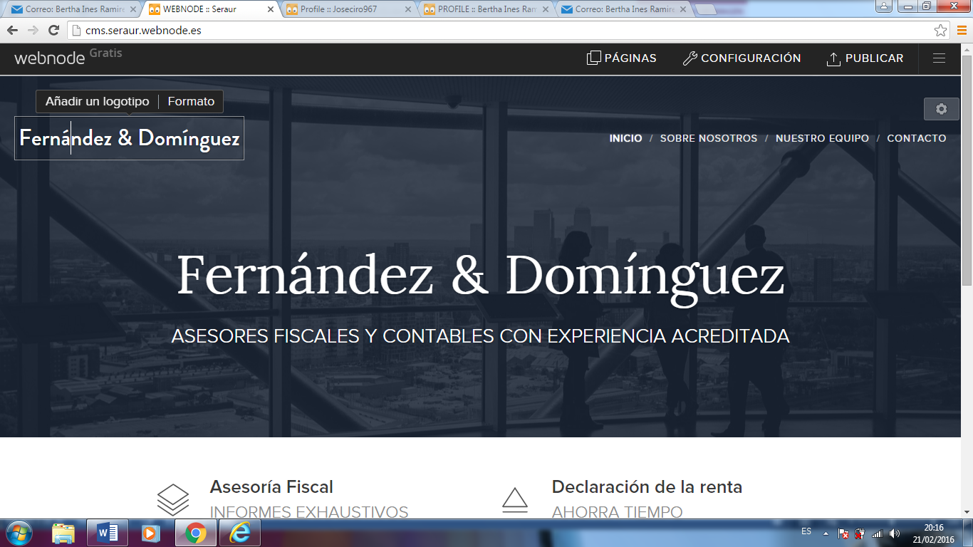
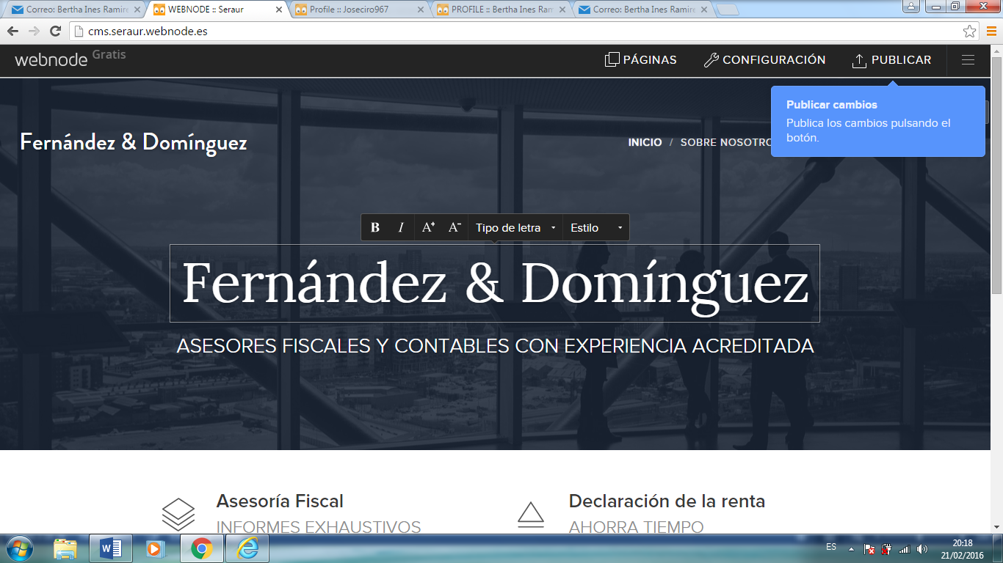
Add a personal logo or your proper name.
Use the tool bar to change the text which can identify your page.

Slide 5
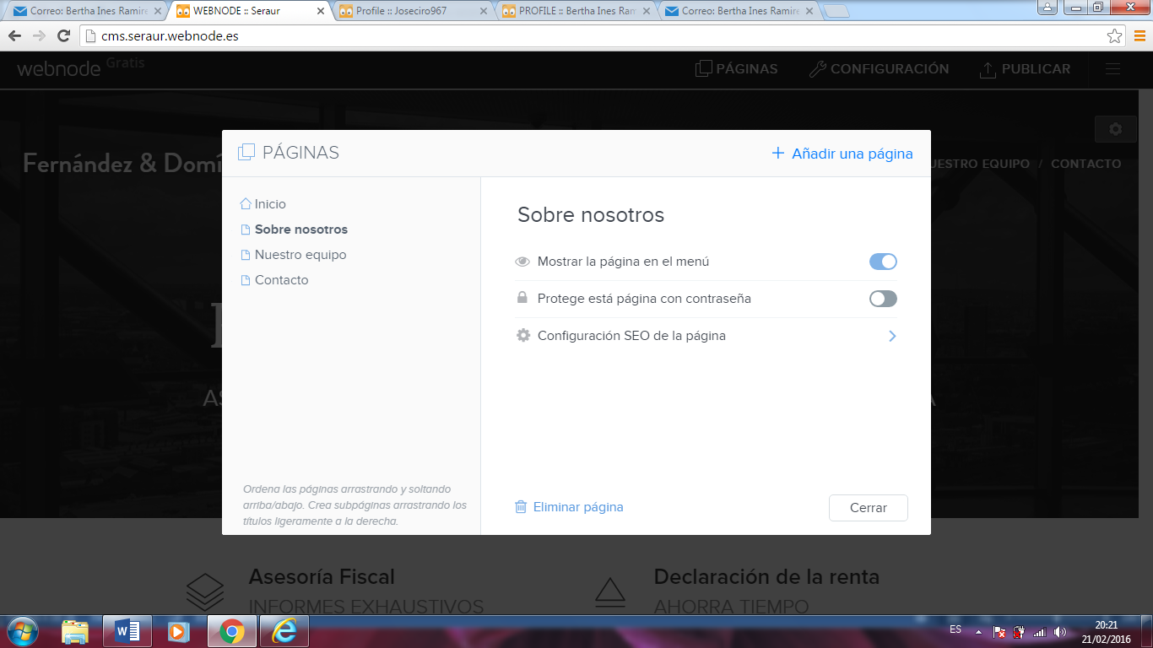
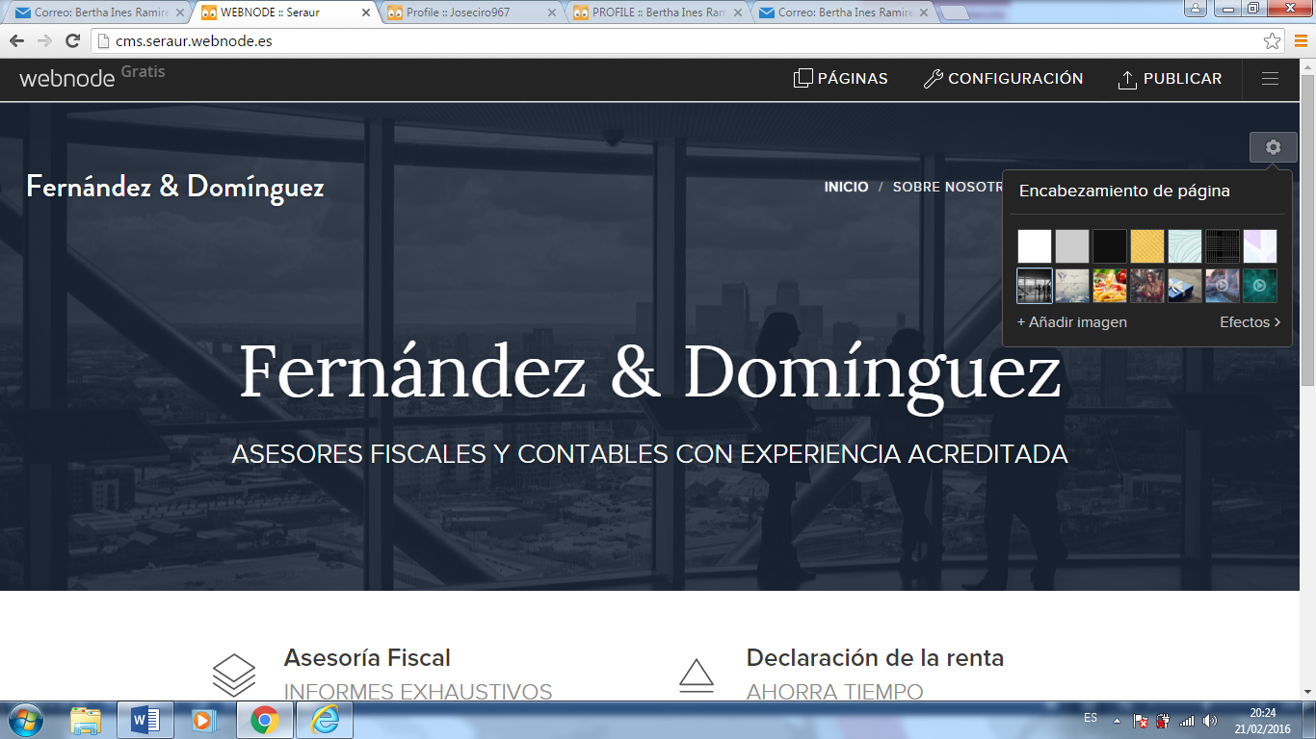
Use this option to modify the name of the page and to add a new page.
To modify the page you can add a pre-establish or personal image.

Slide 6
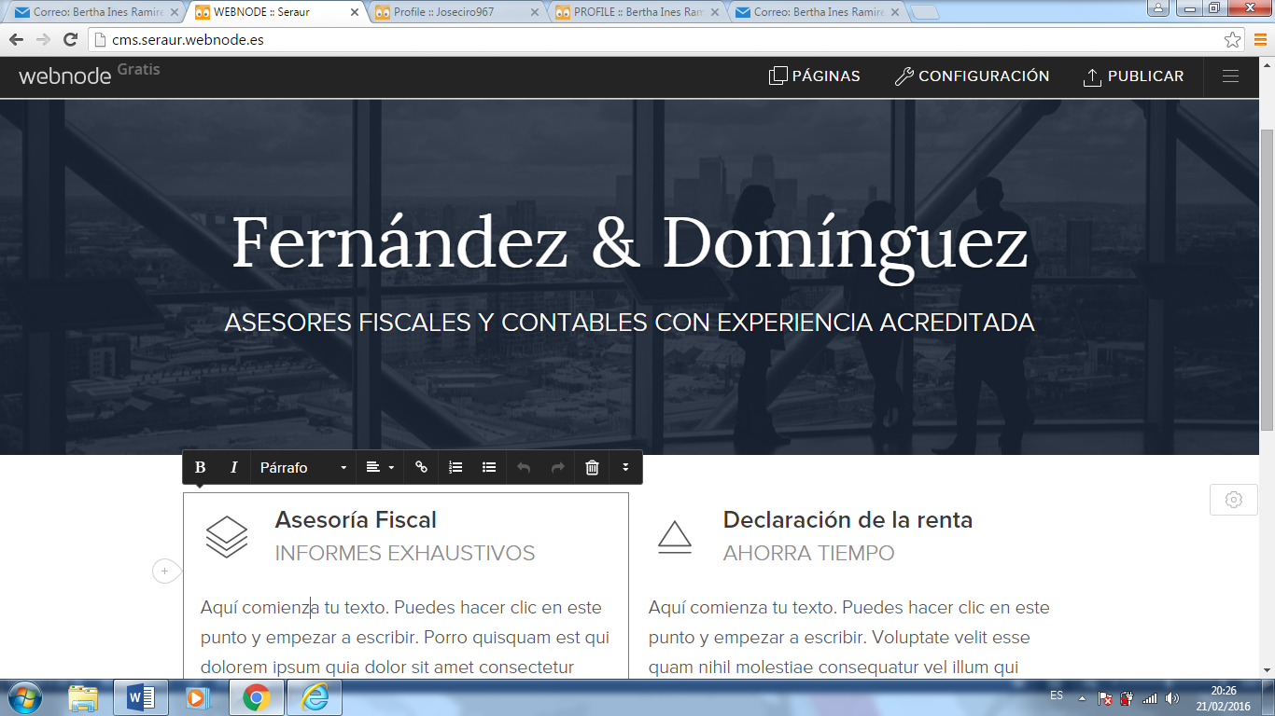
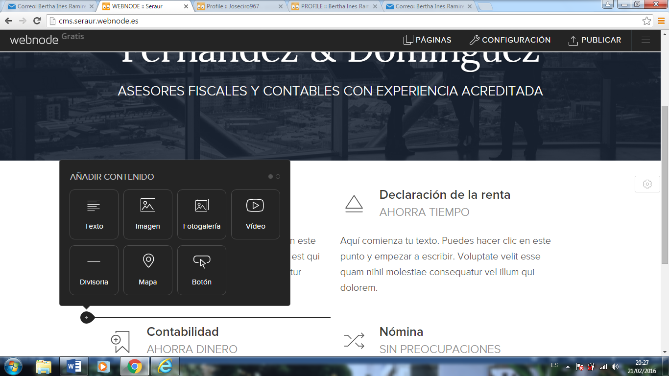
Use the tool bar to change, eliminate or modify the text.
Use the options to add content to the text.

Slide 7
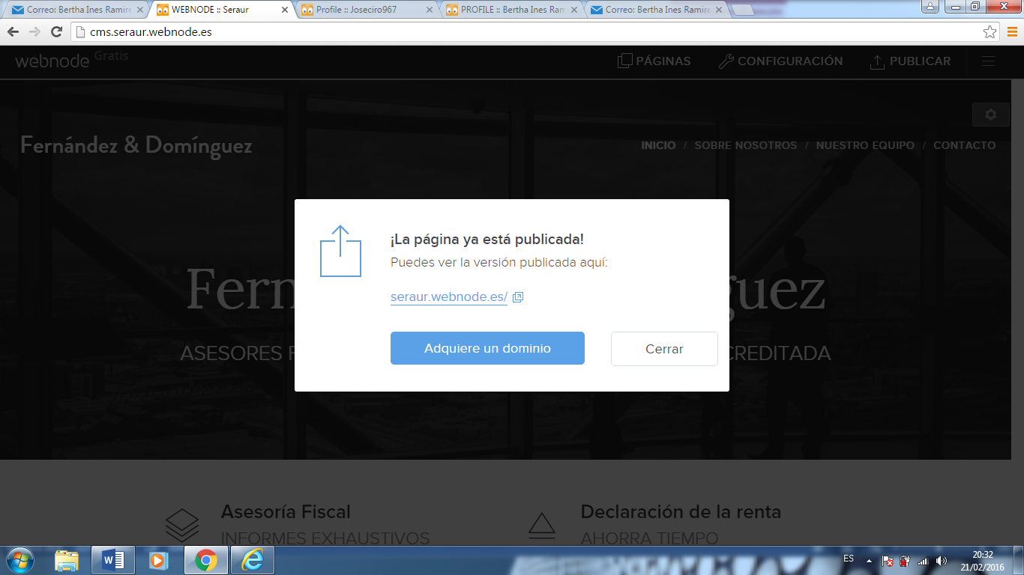
Whenever you make any change or you create a new page, you must click in PUBLICAR , it is on the right upper part of the page.

